Slide 1
Co-culture Growth Curve Analysis

Slide 2
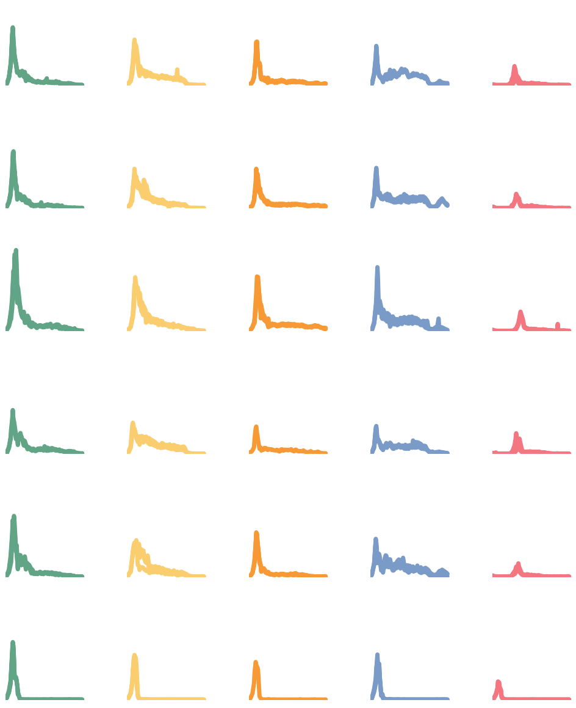
Experiment setup
MED4 MIT9312 MIT0604 Natl2A MIT9313
DE
5 PRO strains
5 ALT strains
All combinations
25 pairs
Control (axenic)
FL measurements
FCM @ 60, 100,140 days
DE1
1A3
ATCC
BS11

Slide 3
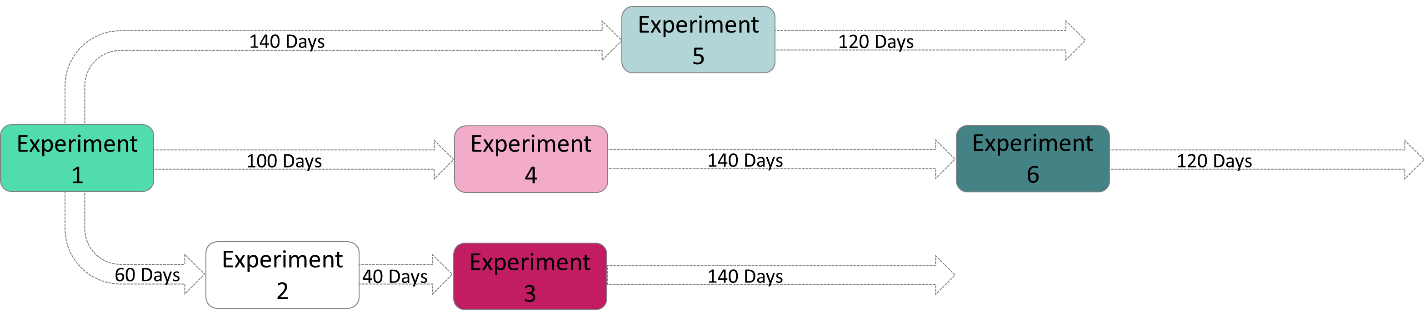
Experiments transfers
The initial samples were transfers and grown multiple times

Slide 4
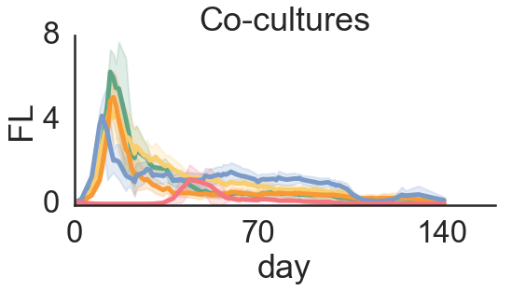
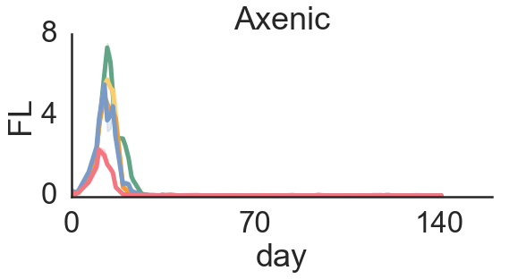
Co-culture better than axenic
Axenic culture died faster and did not survive transfers

Slide 5
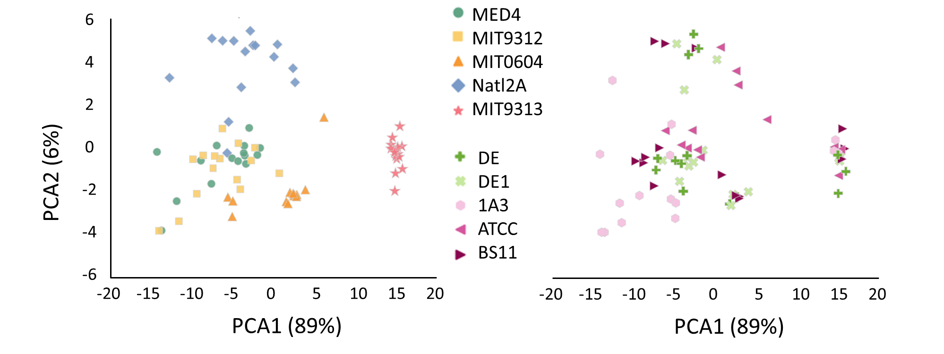
PCA – samples grouped by PRO (and not ALT)

Slide 6
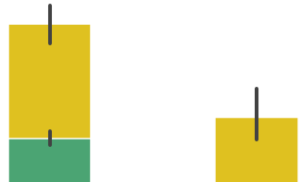
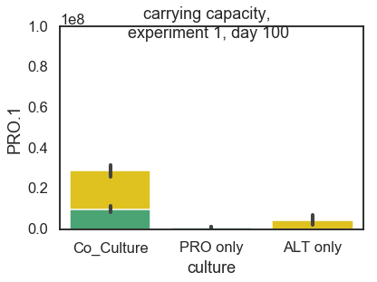
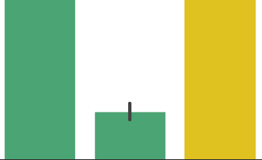
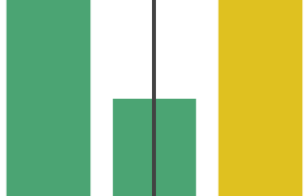
Carrying Capacity
60 Days 100 Days
1.0
0.8
0.6
0.4
0.2
1.0
0.8
0.6
0.4
0.2
Both ALT and PRO have higher cell numbers when grown together
10⁸ Cells/ml
10⁸ Cells/ml
1.0
0.8
0.6
0.4
0.2
0.0
1.0
0.8
0.6
0.4
0.2
0.0
10⁵ Cells/ml
10⁶ Cells/ml
Co-Culture PRO ALT
Co-Culture PRO ALT

Slide 7
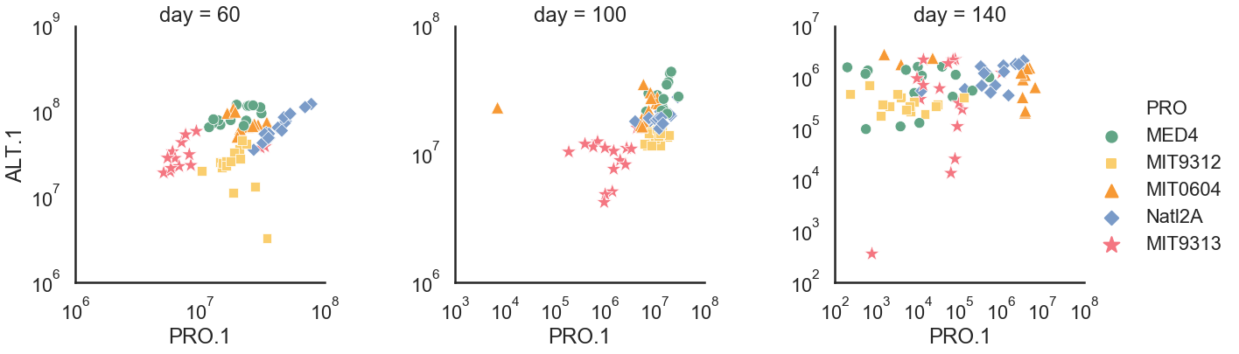
Cell numbers – driven by PRO

Slide 8

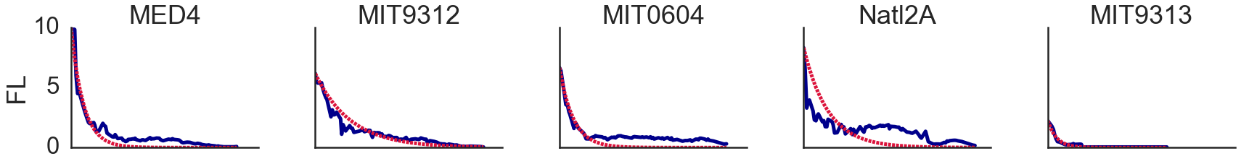
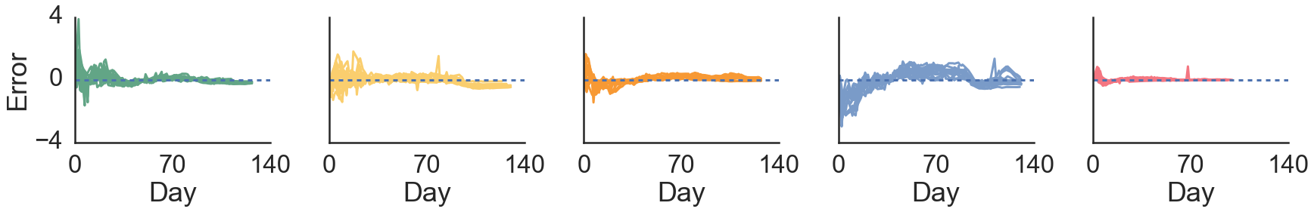
Decline – fit to exponential decline
PRO

Slide 9

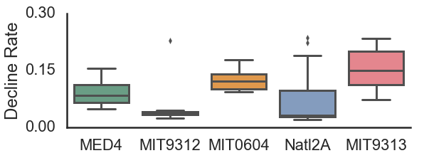
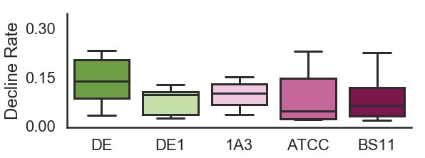
Decline Rate – driven by PRO and not ALT
PRO
ALT
b
a
ab
ac
a
a
a
a
a
c

Slide 10
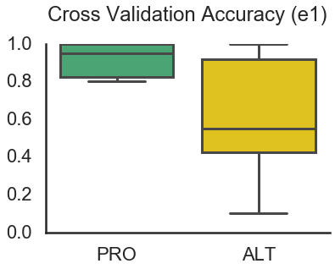
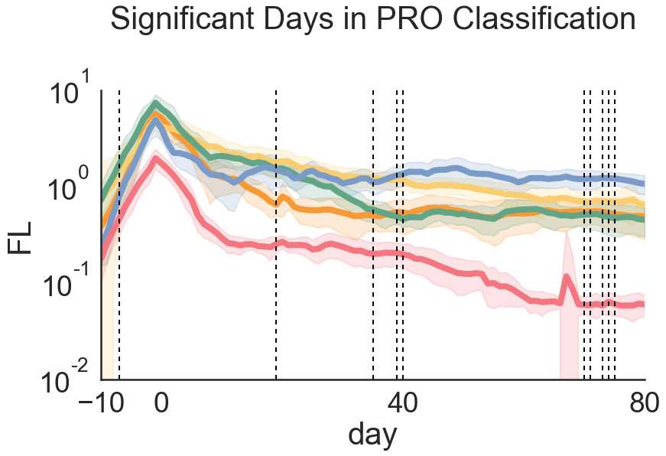
Machine learning – classify strain based on curve
Higher accuracy in predicting PRO strain
These days have highest importance in classification

Slide 11
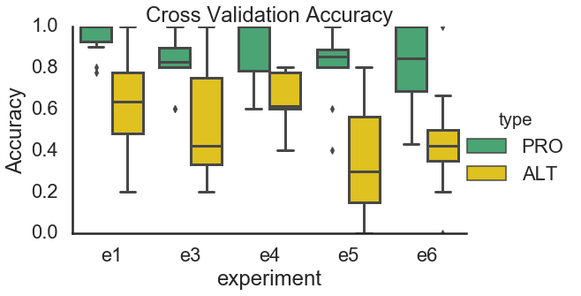
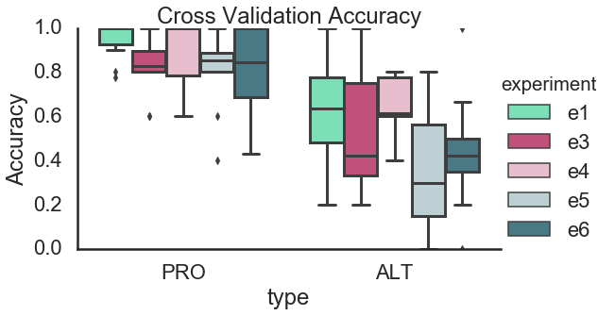

Slide 12
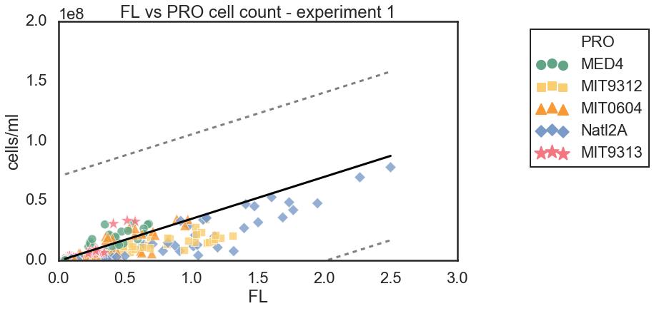
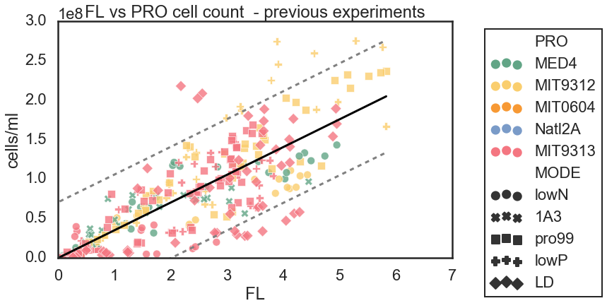
FL as proxy for cell numbers
R2 = 0.49
R2 = 0.69

Slide 13
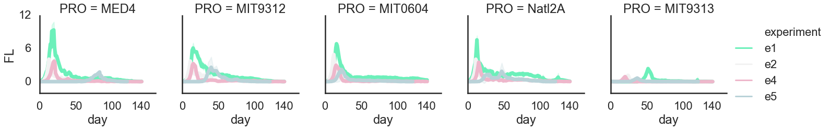
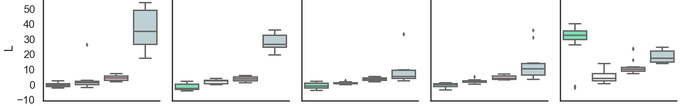
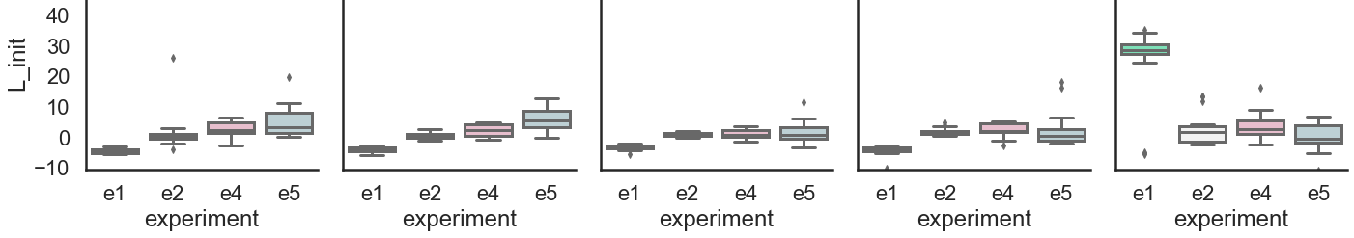
Lag – transfers seems to have higher lag – explained by lower initial cell numbers
LAG based on FL
LAG corrected by FCM

